Slide 1

Image Segmentation
Dr. S.Kandar
Assistant Professor
Department of Information Technology
IIEST, Shibpur

Slide 2
Introduction
Image processing techniques (Enhancement, Restoration) takes a digital image as input and gives out another image (with improved quality).
In image analysis, for the same image the output is the detail description of the scene (in the image).
Segmentation is the first step of image analysis techniques.

Slide 3
Preview
Segmentation is to subdivide an image into its constituent regions or objects.
Segmentation technique divides the spatial domain into ‘meaningful’ parts or regions
meaningful region may be a complete object or may be a part of it.
Segmentation should stop when the objects of interest in an application have been isolated.

Slide 4
Principal approaches
Segmentation algorithms are based on one of the two following approaches:
Satisfying homogeneity property in image feature(s) over a large region.
Extract region
Detecting abrupt change in image feature(s) within a small neighborhood.
Detect border between regions

Slide 5
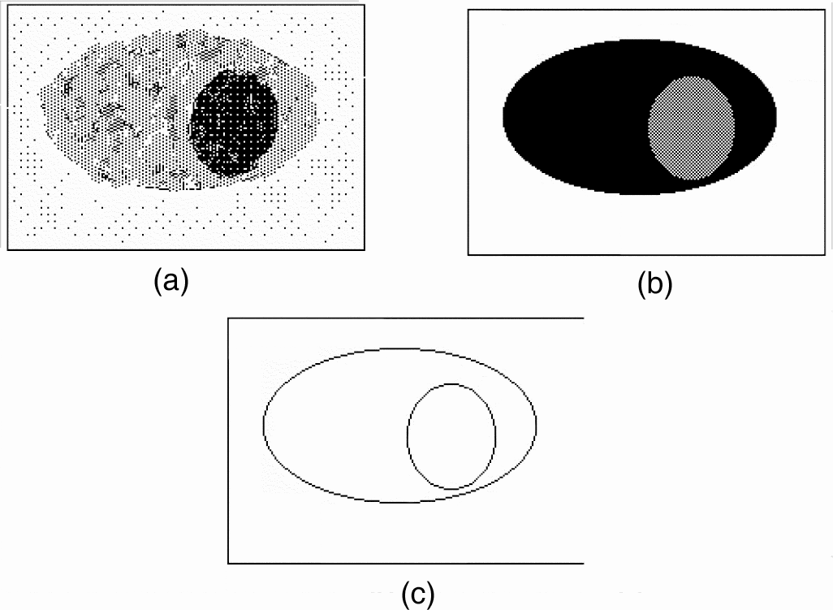
Outputs of various segmentation techniques
(a) input image, (b) expected result of the region-extraction techniques and (c) expected result of edge detection techniques

Slide 6
Types of Image Segmentation algo
Based on user interaction
Based on pixel relationship
Manual
Region based
Semi-automatic
Pixel based
automatic

Slide 7
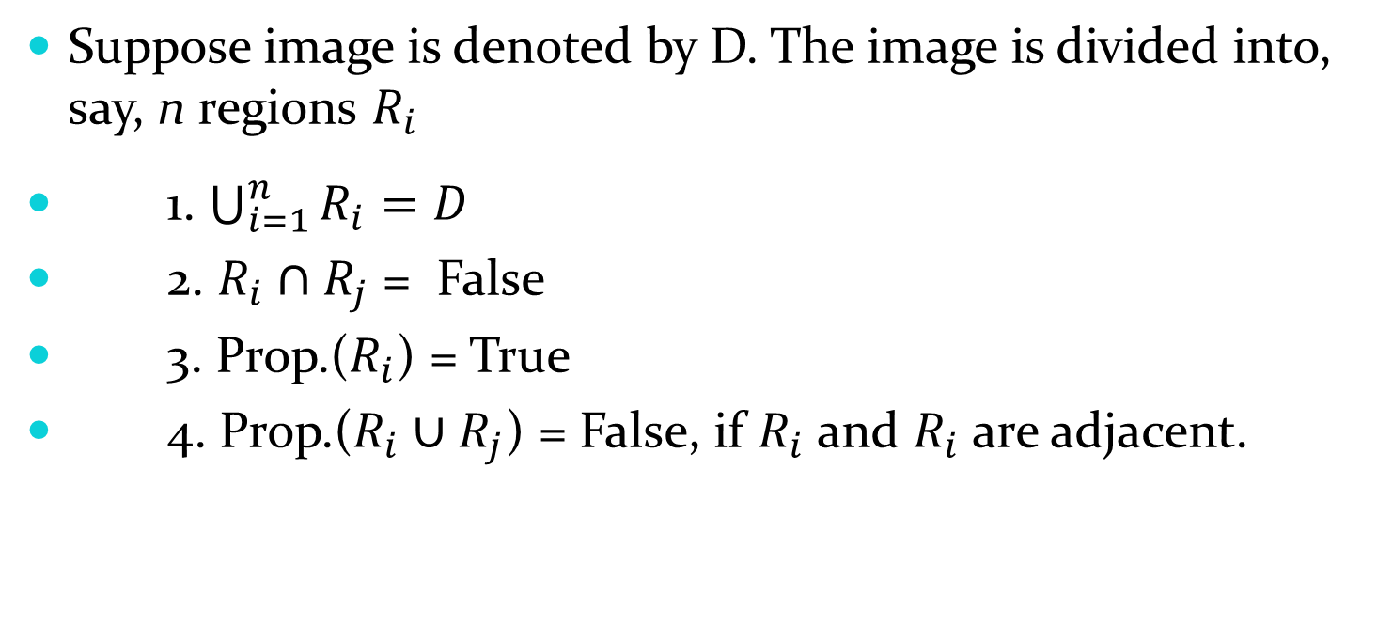
Region Extraction
Suppose image is denoted by D. The image is divided into, say, n regions $R_{i}$
1. $\bigcup_{i=1}^{n}{R_{i}=D}$
2. $R_{i}∩R_{j}$ = False
3. Prop.($R_{i}$) = True
4. Prop.($R_{i}∪R_{j}$) = False, if $R_{i}$ and $R_{i}$ are adjacent.
Let Prop is all the pixels having same intensity

Slide 8
Pixel-based Approach
We consider pixel graylevel as the feature, and image can be segmented by graylevel thresholding.
Selection of optimum threshold is a big challenge.

Slide 9
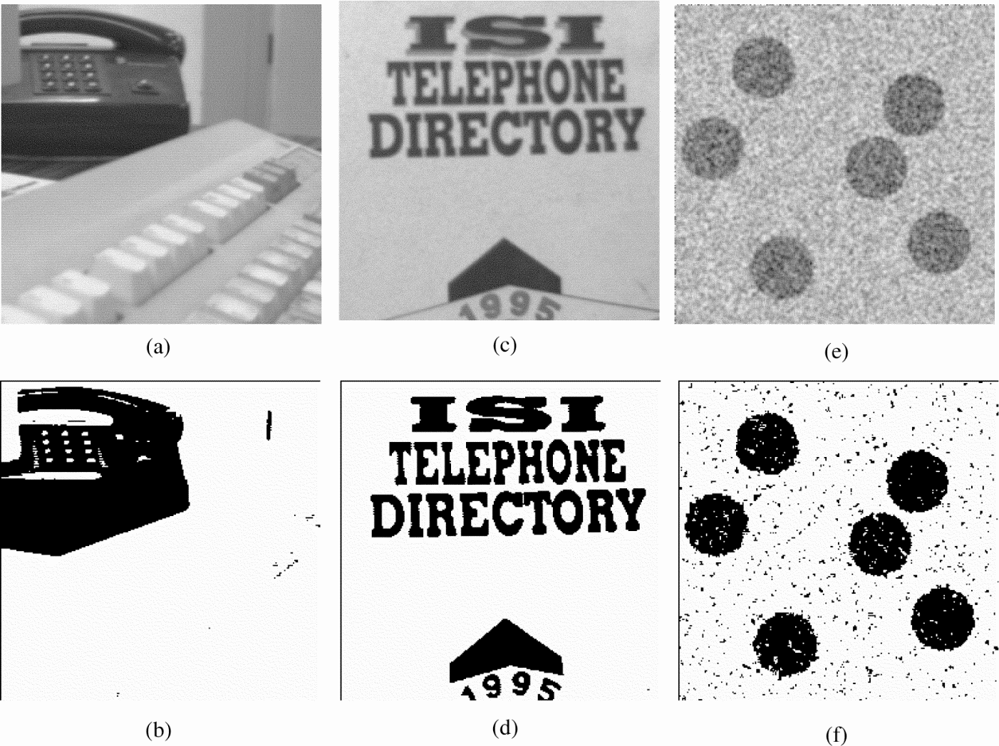
Two regions problem

Slide 10
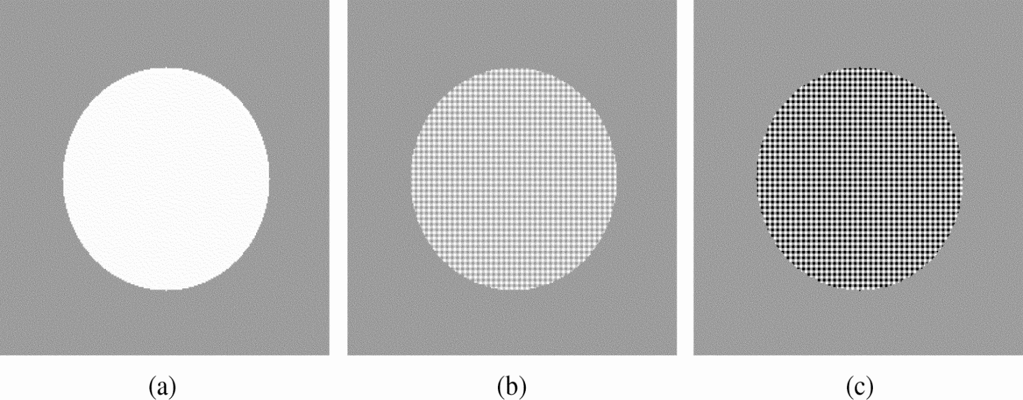
Thresholding
Disk at the centre with uniform background: images can be segmented using different threshold

Slide 11
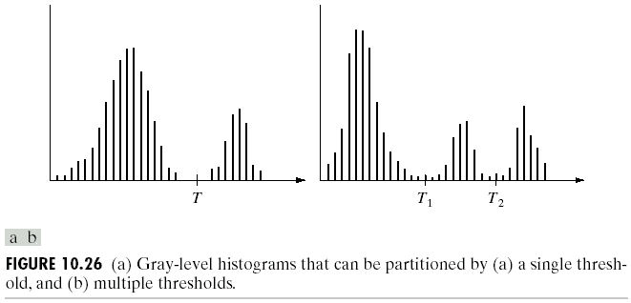
Thresholding
image with dark background and a light object
image with dark background and two light objects

Slide 12
Multilevel thresholding
a point (x,y) belongs to
to an object class if T₁ < f(x,y) ≤ T₂
to another object class if f(x,y) > T₂
to background if f(x,y) ≤ T₁
T depends on
only f(x,y) : only on gray-level values  Global threshold
both f(x,y) and p(x,y) : on gray-level values and its neighbors  Local threshold

Slide 13
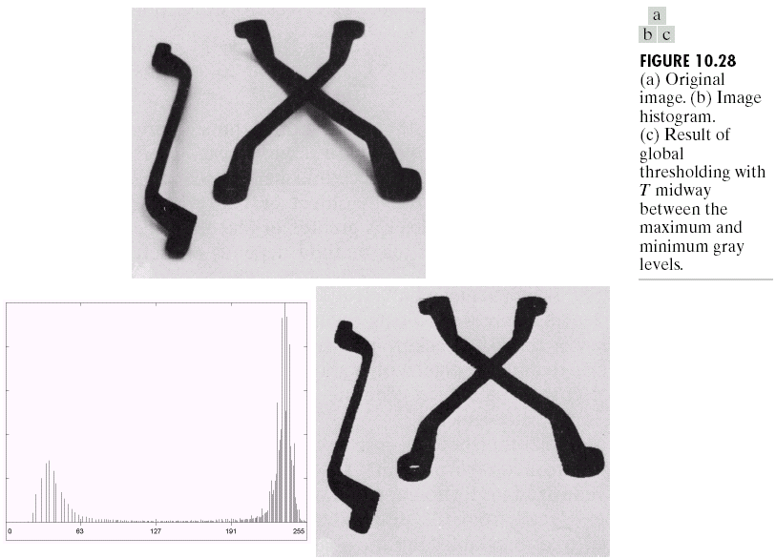
Basic Global Thresholding
use T midway between the max and min gray levels
generate binary image

Slide 14
Basic Global Thresholding
based on visual inspection of histogram
Select an initial estimate for T.
Segment the image using T. This will produce two groups of pixels: G₁ consisting of all pixels with gray level values > T and G₂ consisting of pixels with gray level values ≤ T
Compute the average gray level values μ₁ and μ₂ for the pixels in regions G₁ and G₂
Compute a new threshold value
T = 0.5 (μ₁ + μ₂)
Repeat steps 2 through 4 until the difference in T in successive iterations is smaller than a predefined parameter T_{o}.

Slide 15
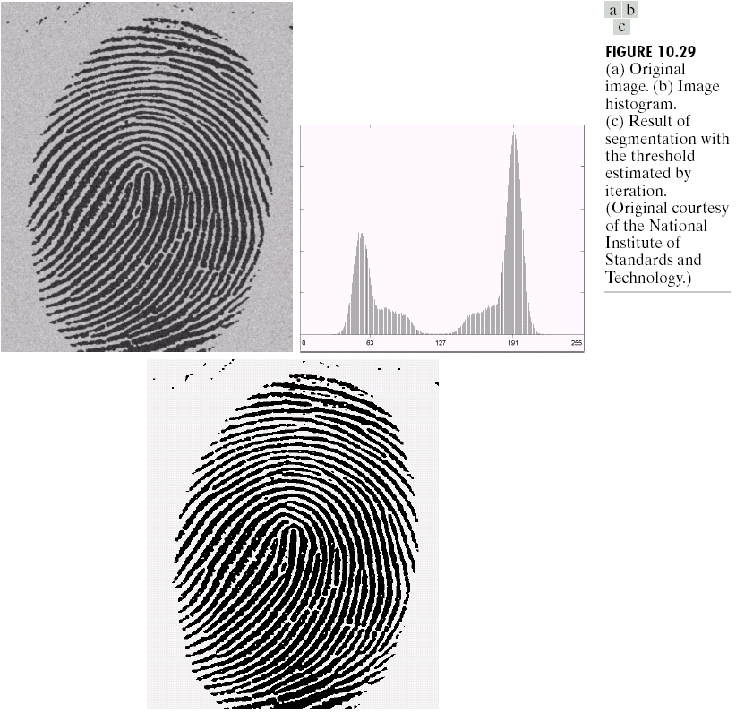
Example
note: the clear valley of the histogram and the effective of the segmentation between object and background
T₀ = 0
3 iterations
with result T = 125

Slide 16
Thresholding
Global Thresholding: When does It NOT Work?
A meaningful global threshold may not exist
Image-dependent
global
thresholding

Slide 17
Basic Adaptive Thresholding
subdivide original image into small areas.
utilize a different threshold to segment each subimages.
since the threshold used for each pixel depends on the location of the pixel in terms of the subimages, this type of thresholding is adaptive.
Useful image statistics for adaptive thresholding
a) Mean+C b) Median+ C c) (Max+Min)/2

Slide 18
Input: Grayscale image I with dimensions M×N, window size W (odd), and a constant offset C.
Output: Binary image B of the same dimensions as I.
Algorithm Steps:
For each non-overlapping window of size W×W within the input image I:
Compute the local mean M of the pixel intensities within the current window.
Compute the threshold value T=M−C.
For each pixel (x,y) within the current window:
If the intensity of the pixel (x,y) is greater than or equal to the threshold T, set the corresponding pixel in the binary image B(x,y) to 1 (foreground).
Otherwise, set B(x,y) to 0 (background).
Output: Binary image B.

Slide 19
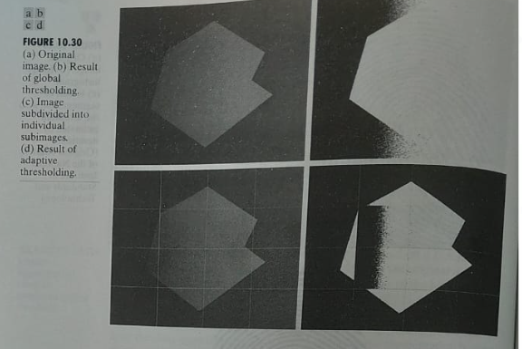
Image is subdivided into four equal parts
Each parts is again subdivided into four equal parts.

Slide 20
Adaptive Thresholding
true object boundary
Thresholding T = 4.5
Thresholding T = 5.5

Slide 21
Adaptive Thresholding
Solution
Spatially adaptive thresholding
Localized processing
Split

Slide 22
Adaptive Thresholding
spatially adaptive threshold selection
Thresholding T = 4
Thresholding T = 7
Thresholding T = 4
Thresholding T = 7

Slide 23
Adaptive Thresholding
merge local segmentation results
merge
merge
merge
merge

Slide 24
Otsu’s Method
Otsu's thresholding or maximum variance thresholding
Used for automatic image segmentation.
Separates an input grayscale image into two classes: foreground and background
Aims to minimize the intra-class variance and maximize the inter-class variance.

Slide 25
Steps:
Histogram Computation
Probability Mass Function (PMF) Calculation: Normalize the histogram to obtain the probability mass function (PMF) of each intensity level. Each value in the PMF represents the probability of encountering a pixel with that intensity.
Cumulative Distribution Function (CDF) Calculation:Compute CDF from the PMF. The CDF represents the cumulative probability of encountering a pixel with intensity less than or equal to a specific level.
Class Separability Calculation: For each possible threshold value T, calculate the class separability, which is a measure of how distinct the classes (foreground and background) are. Can be defined as the ratio of the inter-class variance to the intra-class variance.
Threshold Selection: Find the threshold value T (Otsu Threshold)that maximizes the class separability. In other words, Otsu's method searches for the threshold that minimizes the weighted sum of variances within the two classes.
Image Segmentation: Use the optimal threshold T to segment the input image into foreground and background regions.

Slide 26
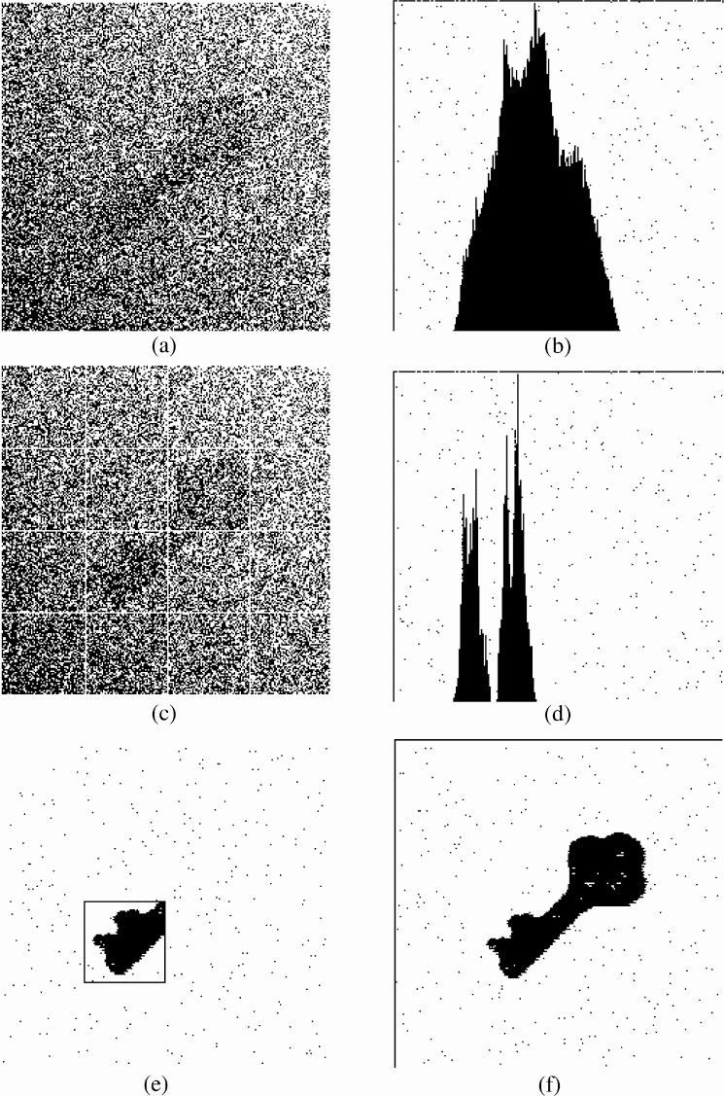
Local thresholding
categorizes a pixel based on the intensity statistics of its neighboring pixels.
original image, (b) graylevel histogram,
(c) subdivisions of the original image, (d) histogram of sub-image located at the 3rd row, 2nd column,
(e) segmented image of the said subdivision and (f) segmented original image.
T= T[x,y, p(x,y), f(x,y)]
f(x,y): gray level point
p(x,y): Some local property of the point.

Slide 27
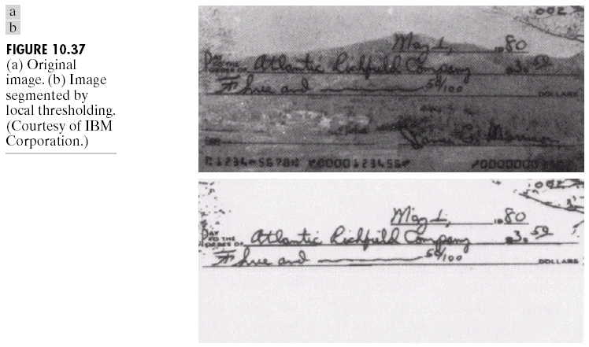
Local thresholding

Slide 28
Local Thresholding with Niblack's Method
Input: Grayscale image I with dimensions M×N, window size W (odd), and a parameter k. (deviation Niblack factor,)
Output: Binary image B of the same dimensions as I.
Algorithm Steps:
For each pixel (x,y) in the input image I:
Define a local neighborhood around the pixel (x,y) with a window of size W.
Compute the local mean M(x,y) and standard deviation S(x,y) of the pixel intensities within the neighborhood.
Compute the threshold value T(x,y)=M(x,y)+k×S(x,y).
if(I(x,y)≥ T(x,y))
B(x,y) = 1 (foreground).
Else B(x,y) = 0 (background).
Output: Binary image B.
If interested study Sauvola local thresholding method

Slide 29
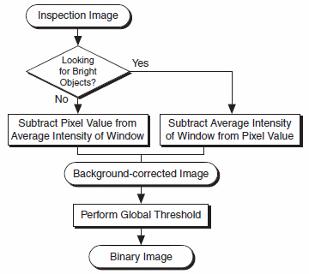
Background Correction Algorithm
This algorithm combines the local and global thresholding concepts for image segmentation.

Slide 30
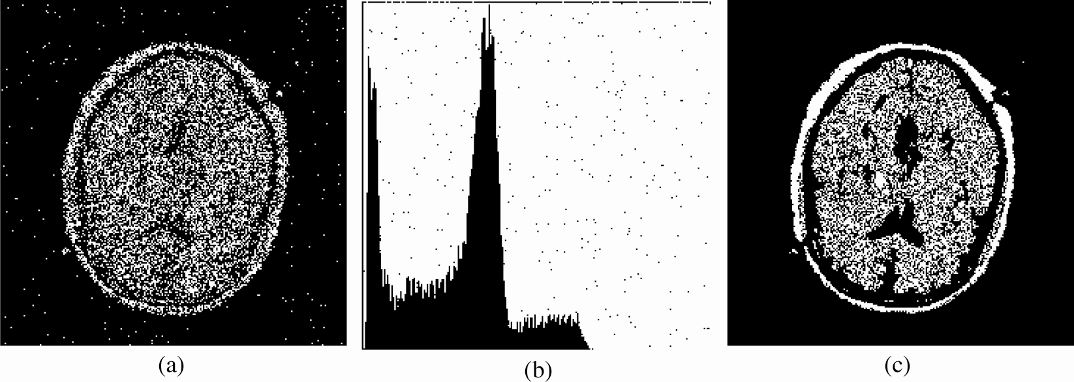
Multilevel Thresholding
More than two dominant modes characterize the histogram.
T₁ < f(x,y) ≤ T₂ one object class
f(x,y) > T₂ Another object class
f(x,y) ≤ T₁ Background

Slide 31
Region-Based Segmentation
Basic Formulation
P(R_{i}) is a logical predicate property defined over the points in set R_{i}
ex. P(R_{i}) = TRUE if all pixel in R_{i} have the same gray level

Slide 32
Region Growing
start with a set of “seed” points
growing by appending to each seed those neighbors that have similar properties such as specific ranges of gray level
This process goes on recursively until no more pixel is accepted.
All the pixels of the current region are marked with a unique label.
Then another seed pixel is picked up and the same procedure is repeated. We go on labeling the regions until every pixel is assigned to some region or the other.

Slide 33
Region Splitting

Slide 34
Region Merging
Select a predicate P ( Let P(R_{i})= TRUE if at least 80% of the pixels in R_{i} have the property |Z_{j} -m_{i}|≤ 2σ_{i} , Z is gray level, m is the mean gray level of the region, σ_{i} is the standard deviation
If P(R)= FALSE divide the image into quadrant.

Slide 35
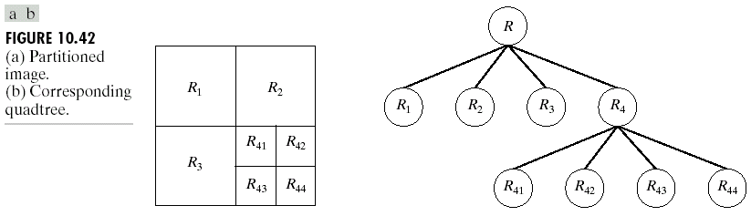
Region splitting and merging
Quadtree
Split into 4 disjoint quadrants any region R_{i} for which P(R_{i}) = FALSE
Merge any adjacent region R_{j} and R_{k} for which P(R_{i} ∪ R_{k} ) = TRUE
Stop when no further merging or splitting is possible.

Slide 36
Region splitting and merging
Example: Quadtree Split and Merge Procedure
Iteration 1
split
merge
original image
4 regions
4 regions
(nothing to merge)
Split Step → split every non-uniform region to 4
Merge Step → merge all uniform adjacent regions

Slide 37
Region-Based Method: Split and Merge
Example: Quadtree Split and Merge Procedure
Iteration 2
split
merge
from Iteration 1
13 regions
4 regions
Split Step → split every non-uniform region to 4
Merge Step → merge all uniform adjacent regions

Slide 38
Region-Based Method: Split and Merge
Example: Quadtree Split and Merge Procedure
Iteration 3
split
merge
from Iteration 2
10 regions
2 regions
Split Step → split every non-uniform region to 4
Merge Step → merge all uniform adjacent regions
final segmentation result

Slide 39



Boundary-Based Method
edge
detection
boundary
detection
classification
and labeling
image
segmentation

Slide 40
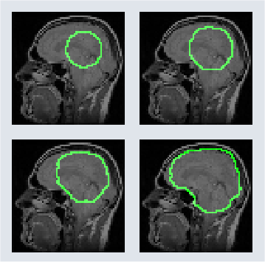
Boundary-Based Method
Advanced Method: Active Contour (Snake) Model
Iteratively update contour (region boundary)
Partial differential equation (PDE) based optimization
From Prof. Xin Li

Slide 41
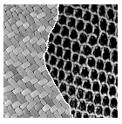
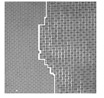
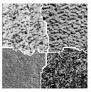
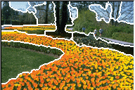
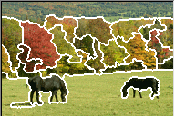
Hard Problem: Textures
Similarity measure makes the difference
From Prof. Xin Li

Slide 42
Principal approaches
Segmentation algorithms are based on one of the two following approaches:
Satisfying homogeneity property in image feature(s) over a large region.
Extract region
Detecting abrupt change in image feature(s) within a small neighborhood.
Detect border between regions

Slide 43
Detection of Discontinuities
detect the three basic types of gray-level discontinuities
points , lines , edges
the common way is to run a mask through the image

Slide 44
Point Detection
a point has been detected at the location on which the mark is centered if
|R| ≥ T
where
T is a nonnegative threshold and R= w₁z₁ + w₂z₂ + …+ w₉z₉

Slide 45
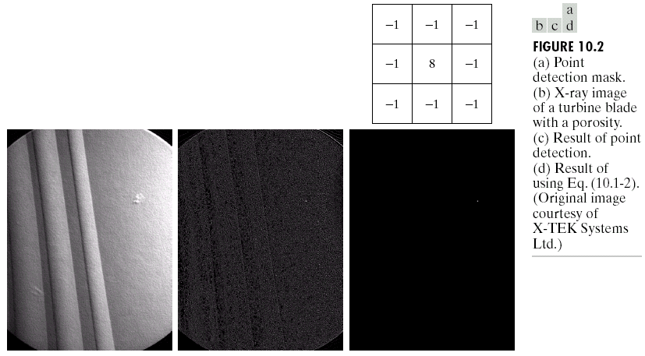
Example
a) Mask
b) Original image
c) Result of point detection
d) With threshold T = 90% of the highest pixel value
a
b
c
d

Slide 46
Line Detection
For a line, the graylevel is relatively constant along a thin strip.
There will be a spike-like cross-section in the ideal case, if the graylevels on either sides are the same, which looks like an uneven spike if the graylevels on either sides differ.
When combined with noise and blurring, the cross-section may look like a roof in one dimension.

Slide 47
Line Detection
a b c
a an ideal line
b a line when gray levels on both sides are not same
c a noisy line

Slide 48
Line Detection
a a a
b b b
a a a
max response when a line passed through the middle row of the mask with a constant background.
note: the preferred direction of each mask is weighted with a larger coefficient (i.e.,2)
the similar idea is used with other masks.

Slide 49
Line Detection
Apply every masks on the image
let R₁, R₂, R₃, R₄ denotes the response of the horizontal, +45⁰, vertical and -45⁰ masks, respectively.
if, at a certain point in the image
|R_{i}| > |R_{j}|,
for all j≠i, that point is said to be more likely associated with a line in the direction of mask i.

Slide 50
Example
a) Original image, b) result of line detection

Slide 51
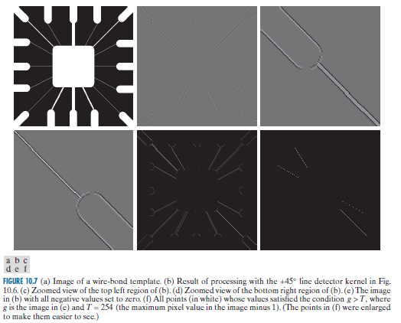
Example

Slide 52
Line Detection
Some assumptions on above method:
The width of a line does not exceed three pixels.
The contrast between a line and its background exceeds a given and constant threshold value.
We detect only one type of line (bright or dark) at a time.

Slide 53
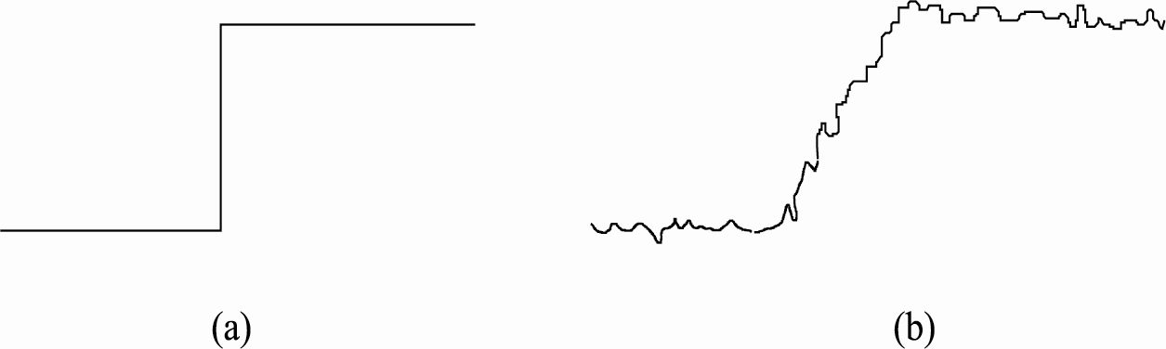
Edge detection
Edge detection is the most common approach for detecting meaningful discontinuities in gray level.
edge is a local feature that, within a neighborhood, separates two regions in each of which the gray level is more or less uniform with different values on the two sides of the edge.
an ideal edge has a step like cross-section as shown in Fig. (a). More realistic edge (shown in (b)) which has a shape of ramp function corrupted with noise.

Slide 54
Edge detection
The process of edge detection are broadly classified into two categories:
Derivative approach: Edge pixels are detected by taking derivative followed by thresholding
Pattern fitting approach: the edge template which fits best, based on this information then decided whether or not an edge is present.

Slide 55
Basic Formulation
an edge is a set of connected pixels that lie on the boundary between two regions.
an edge is a “local” concept whereas a region boundary, owing to the way it is defined, is a more global idea.

Slide 56
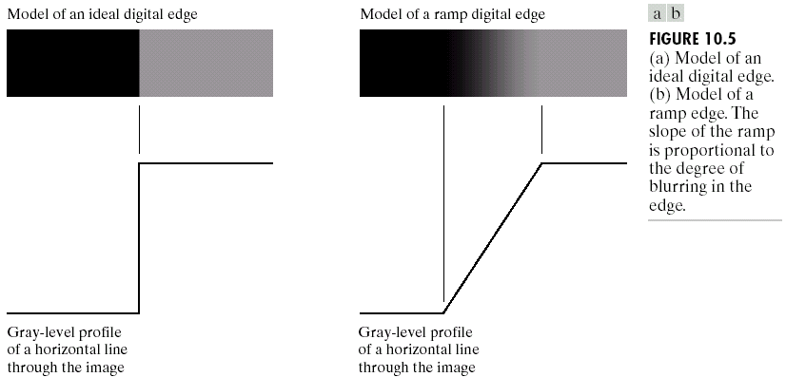
Ideal and Ramp Edges
because of optics, sampling, image acquisition imperfection

Slide 57
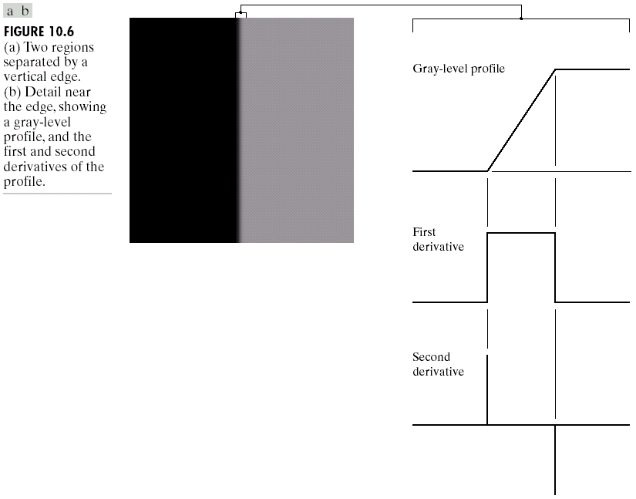
First and Second derivatives
Two values for edges and zero crossing
the signs of the derivatives would be reversed for an edge that transitions from light to dark

Slide 58
Second derivatives
produces 2 values for every edge in an image (an undesirable feature)
an imaginary straight line joining the extreme positive and negative values of the second derivative would cross zero near the midpoint of the edge. (zero-crossing property)
quite useful for locating the centers of thick edges

Slide 59
Edge point
to determine a point as an edge point
the transition in grey level associated with the point has to be significantly stronger
use threshold to determine whether a value is “significant” or not.
Segmentation: assemble edge segments into longer edges.

Slide 60
Gx = g(x, y) – g(x – 1, y)
Gy = g(x, y) – g(x, y – 1)

Slide 61
Gradient Operator
first derivatives are implemented using the magnitude of the gradient.
commonly approx.
the magnitude becomes nonlinear

Slide 62
Gradient direction
Let α (x,y) represent the direction angle of the vector ∇f at (x,y)
α (x,y) = tan⁻¹(Gy/Gx)
The direction of an edge at (x,y) is perpendicular to the direction of the gradient vector at that point

Slide 63
Gradient Masks

Slide 64
Diagonal edges with Prewitt and Sobel masks
Ordinary operator
4-Neighbour operator

Slide 65
Gradient-Based Methods
Motivation
Detect sudden changes in image intensity
Gradient: sensitive to intensity changes
image
Gradient
operator
edge
map
Thresholding
x(m,n)
g(m,n)
e(m,n)
edge pixel
threshold
Gradient:
non edge pixel

Slide 66
Gradient-Based Methods
original image

Slide 67
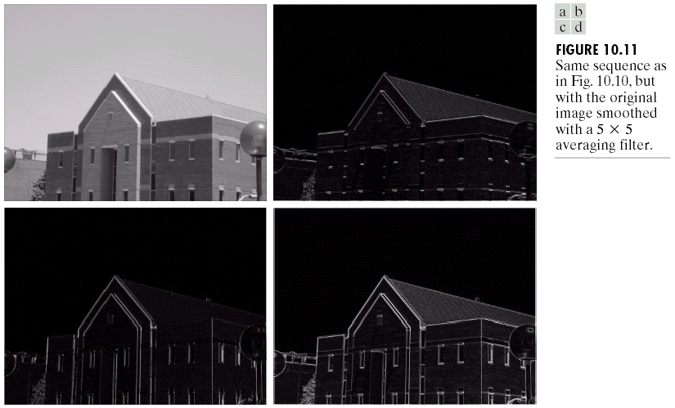
Example

Slide 68
Example
Same sequence as previous, original image is smoothed with 5 x 5 averaging filter

Slide 69
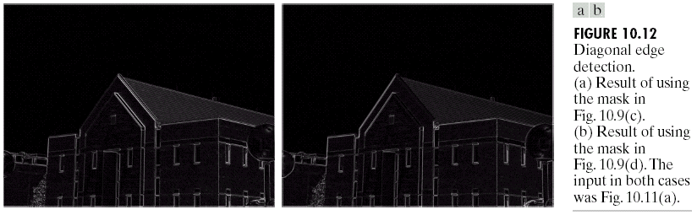
Example

Slide 70
Examples
A 9x9 original image is given by
1) Use Robert gradient operator to find its edges
2) Use Sobel gradient operator to find its edges
Use to estimate the gradient magnitude, and use T = 5 as the threshold for edge detection
Use to estimate the gradient magnitude, and use T = 20 as the threshold for edge detection

Slide 71
Examples
1) Use Robert gradient operator
original image
G_{x}
edge map
original image
thresholding
T = 5
G_{y}
Note: 8x8 images (because of boundary problem)

Slide 72
Examples
2) Use Sobel gradient operator
g₁
edge map
original image
g₂
thresholding
T = 20
Note: 7x7 images (because of boundary problem)

Slide 73
Gradient-Based Methods: Canny Edge Detector
Problems with standard gradient edge detectors
noise-sensitive; thick edge; broken edge contour; hard to pick threshold
image
Canny Edge Detector
smoothing with Gaussian
differentiating along x and y axis
finds peaks in gradient image
thresholding
thinning (locating edge strings)
edge map

Slide 74

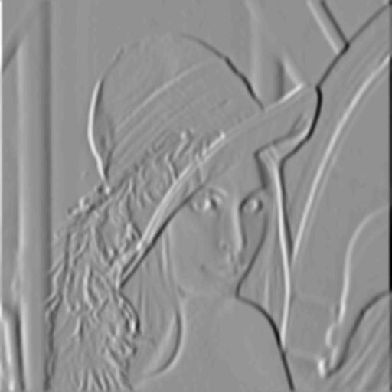
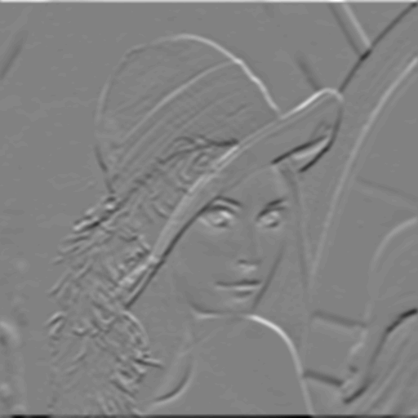
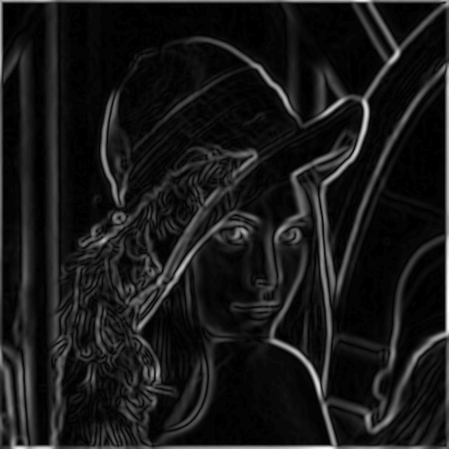
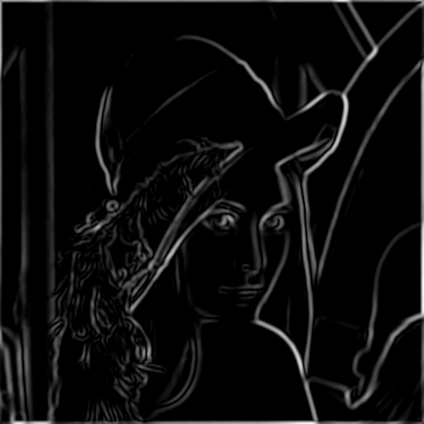
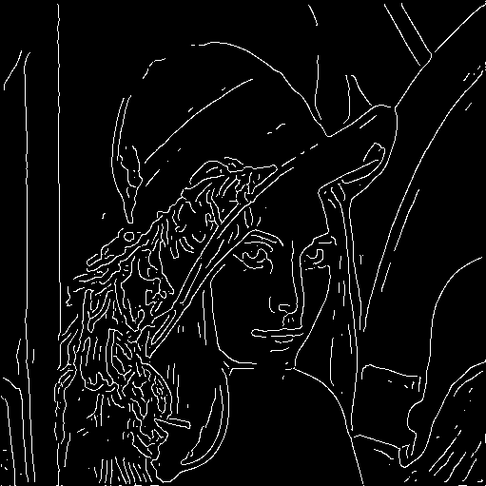
Gradient-Based Methods: Canny Edge Detector
original image
horizontally filtered
vertically filtered
gradient magnitude
after thresholding
after thinning

Slide 75
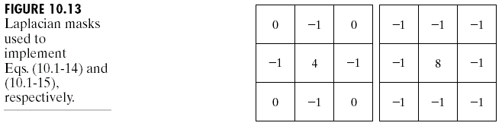
Laplacian
Laplacian operator
(linear operator)

Slide 76
Edge Linking and Boundary Detection
edge detection algorithm are followed by linking procedures to assemble edge pixels into meaningful edges.
Basic approaches
Local Processing
Global Processing via the Hough Transform
Global Processing via Graph-Theoretic Techniques

Slide 77
Local Processing
analyze the characteristics of pixels in a small neighborhood (say, 3x3, 5x5) about every edge pixels (x,y) in an image.
all points that are similar according to a set of predefined criteria are linked, forming an edge of pixels that share the given criteria.

Slide 78
Criteria
the strength of the response of the gradient operator used to produce the edge pixel
an edge pixel with coordinates (x₀,y₀) in a predefined neighborhood of (x,y) is similar in magnitude to the pixel at (x,y) if
|∇f(x,y) - ∇f (x₀,y₀) | ≤ E

Slide 79
Criteria
the direction of the gradient vector
an edge pixel with coordinates (x₀,y₀) in a predefined neighborhood of (x,y) is similar in angle to the pixel at (x,y) if
|α(x,y) - α (x₀,y₀) | < A

Slide 80
Criteria
A point in the predefined neighborhood of (x,y) is linked to the pixel at (x,y) if both magnitude and direction criteria are satisfied.
the process is repeated at every location in the image
a record must be kept
simply by assigning a different gray level to each set of linked edge pixels.

Slide 81
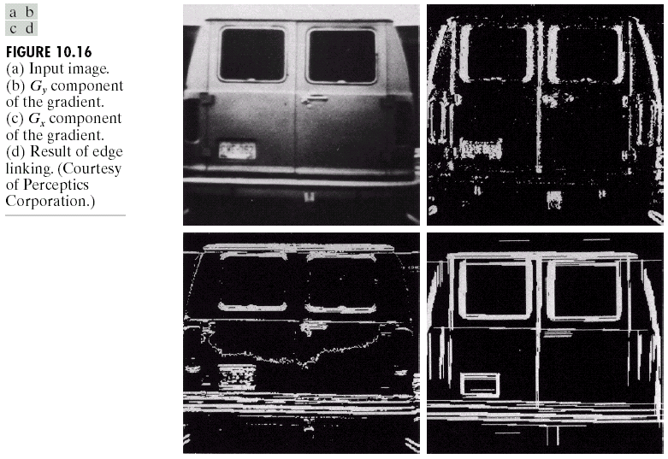
Example
find rectangles whose sizes makes them suitable candidates for license plates
use horizontal and vertical Sobel operators
eliminate isolated short segments
link conditions:
gradient value > 25
gradient direction differs < 15°

Slide 82
Global Processing
Points are linked by determining first if they are lie on a curve of specified shape.
Rather than local properties, here global relationship between pixels are considered.
Given n points, find the all subsets of points which are on a line.
n³-complexity algorithm.

Slide 83
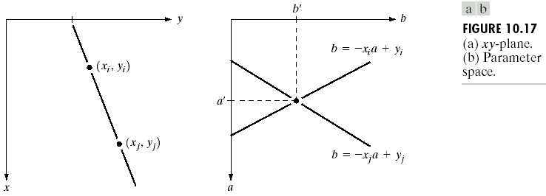
Hough Transformation (Line)
xy-plane
ab-plane or parameter space
y_{i} =ax_{i} + b
b = - ax_{i} + y_{i}
all points (x_{i} ,y_{i}) contained on the same line must have lines in parameter space that intersect at (a’,b’)

Slide 84
Accumulator cells
(a_{max}, a_{min}) and (b_{max}, b_{min}) are the expected ranges of slope and intercept values.
all are initialized to zero
if a choice of a_{p} results in solution b_{q} then we let A(p,q) = A(p,q)+1
at the end of the procedure, value Q in A(i,j) corresponds to Q points in the xy-plane lying on the line y = a_{i}x+b_{j}
b = - ax_{i} + y_{i}

Slide 85
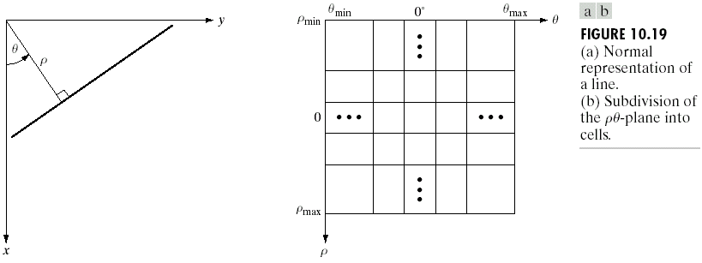
ρθ-plane
ρθ-plane
x cos θ+ y sin θ= ρ
= ±90° measured with respect to x-axis
problem of using equation y = ax + b is that value of a is infinite for a vertical line.
To avoid the problem, use equation x cos θ+ y sin θ = ρ to represent a line instead.
vertical line has θ = 90° with ρ equals to the positive y-intercept or θ = -90° with ρ equals to the negative y-intercept

Slide 86
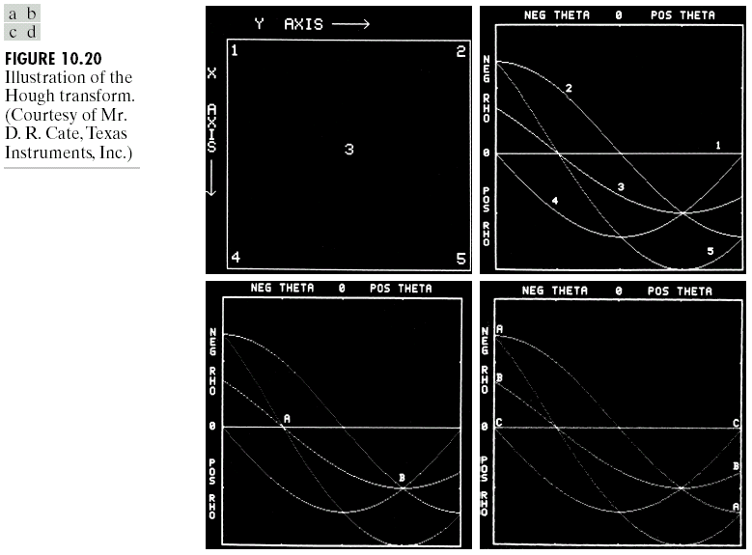
where D is the distance between corners in the image

Slide 87
Generalized Hough Transformation
can be used for any function of the form
g(v,c) = 0
v is a vector of coordinates
c is a vector of coefficients

Slide 88
Hough Transformation (Circle)
equation:
(x-c₁)² + (y-c₂)² = c₃²
three parameters (c₁, c₂, c₃)
cube like cells
accumulators of the form A(i, j, k)
increment c₁ and c₂ , solve of c₃ that satisfies the equation
update the accumulator corresponding to the cell associated with triplet (c₁, c₂, c₃)

Slide 89
Edge-linking based on Hough Transformation
Compute the gradient of an image and threshold it to obtain a binary image.
Specify subdivisions in the ρθ-plane.
Examine the counts of the accumulator cells for high pixel concentrations.
Examine the relationship (principally for continuity) between pixels in a chosen cell.

Slide 90
Continuity
based on computing the distance between disconnected pixels identified during traversal of the set of pixels corresponding to a given accumulator cell.
a gap at any point is significant if the distance between that point and its closet neighbor exceeds a certain threshold.

Slide 91
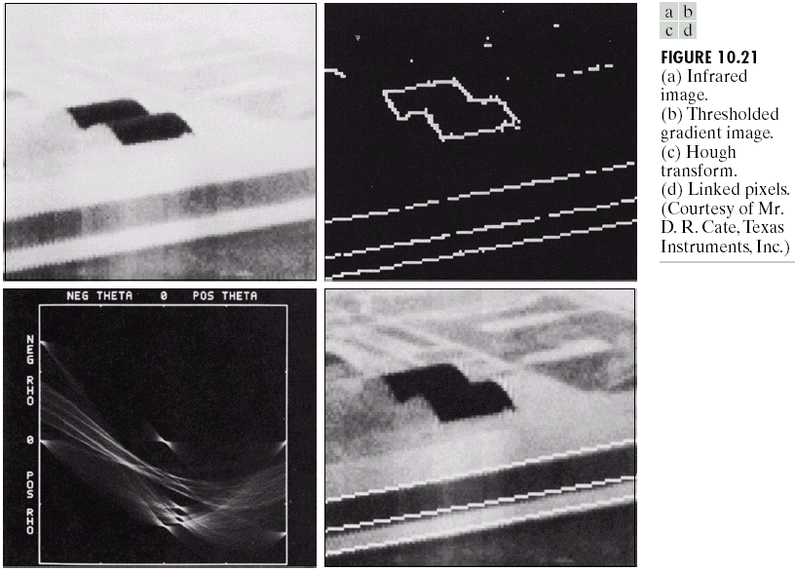
link criteria:
1). the pixels belonged to one of the set of pixels linked according to the highest count
2). no gaps were longer than 5 pixels

Slide 92
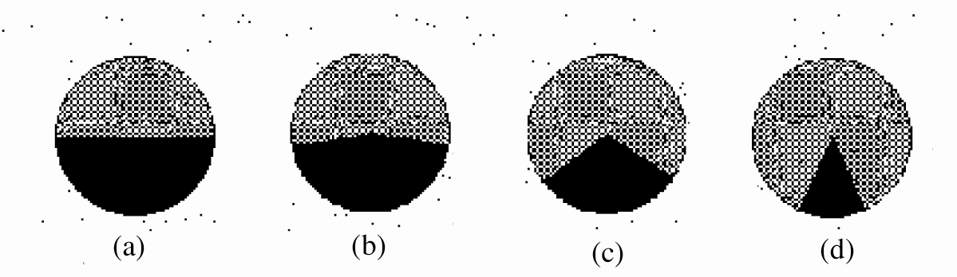
Corner Detection
A corner provides another major shape feature.
Corner is an image point with high contrast along the directions.
That means all the corner points are also edge points.
(a) not a corner point, (b) weak corner, (c) sharp corner, (d) very sharp corner.

Slide 93
Corner Detection
The corner-detection techniques can be classified into two major groups:
1. Curvature- or contour-based techniques
2. Operator-based techniques

Slide 94
Contour-based Corner Detection
Extract contours from the image and label them.
For each contour, traverse along the contour and at each point, compute slope (or curvature) of the contour.
Label a point on the contour as corner point if there is a significant change in slope (or curvature) with respect to the previous point visited.
Performance of this method, thus, largely depends on that of contour extraction process. Hence, the approach observes a limited success for noisy images.

Slide 95
Operator-based Corner Detection
Top-right corner of binary object can be detected by applying binary hit-and-miss transform with following structuring elements
Designing operator for detecting corners in graylevel image gets complicated due to variation in its contrast, sharpness and orientation.
x | x
x | x
x | x | x
 | _ | x
 |  | x

